Slide 1
Tx Driver - CML
1 Gbps
Muhammad Aldacher

Slide 2
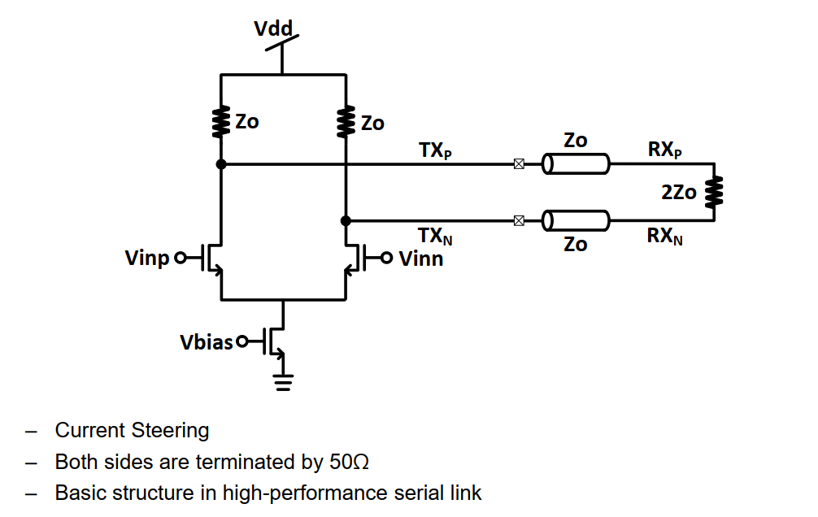

Current-Mode Logic (CML)
$$V_{{Swing}_{(pk2pk)}}$$
Higher Vswing means:
Higher SNDR, but Higher Power also

Slide 3
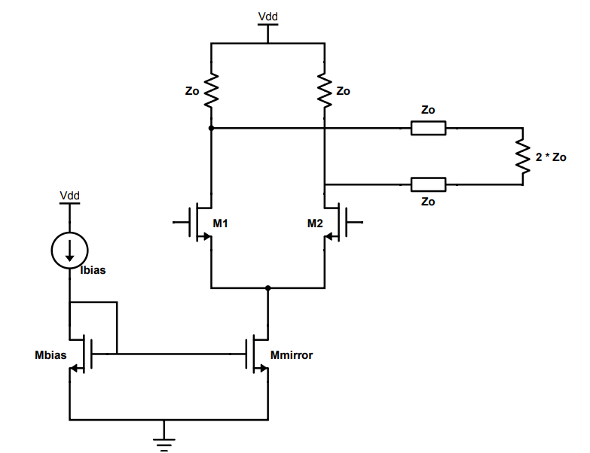

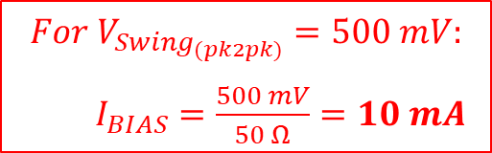


1) Without Replica
$$V_{{Swing}_{(pk2pk)}}=V_{out+}−V_{out−}$$
$$V_{{Swing}_{(pk2pk)}}=I_{BIAS}∗Z_{O}$$
$$For V_{{Swing}_{(pk2pk)}}=500 mV:$$
$I_{BIAS}=\frac{500 mV}{50 Ω}=10 mA$
Vout–
Vout+
Vin+
Vin–
Device Sizing:
Input devices (M1 & M2) act as switches, so we should increase W (reducing RON) to improve headroom.
Bias devices (Mbias & Mmirror) should have large L to reduce channel length modulation. Also we need to increase their W to reduce their VGS & VOV.
$$I_{BIAS}$$
M1 = M2 : L = LMIN , m=100x
Mbias = Mmirror : L = 4 * LMIN , m=200x

Slide 4
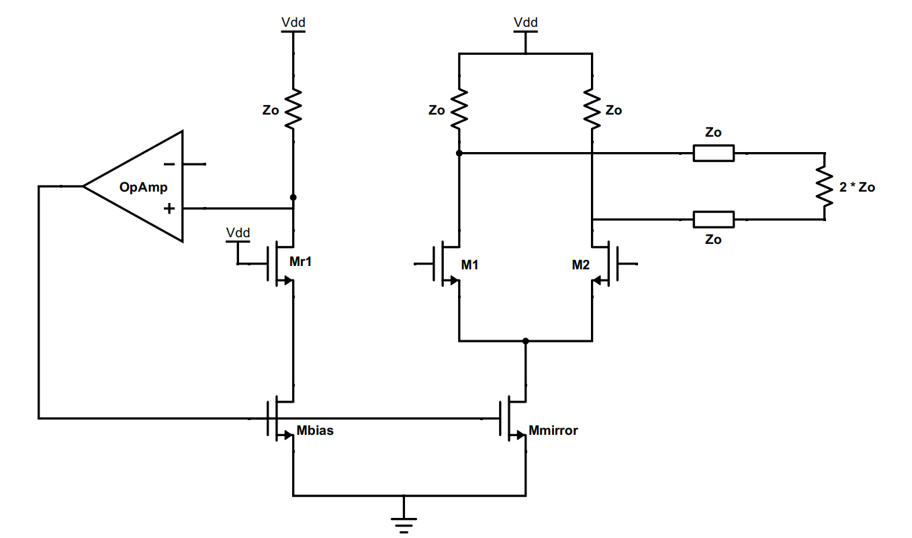

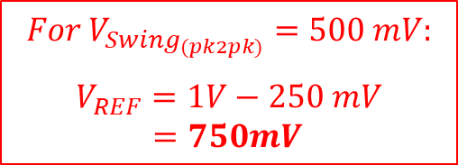


2) With Replica
$$V_{Ref}=V_{DD}−I_{BIAS}∗Z_{O}$$
$$V_{{Swing}_{(pk2pk)}}=V_{DD}−V_{REF}$$
$$For V_{{Swing}_{(pk2pk)}}=500 mV:$$
$$V_{REF}=1V−250 mV$$ $=750mV$
$$V_{REF}$$
Vout–
Vout+
Vin+
Vin–
M1 = M2 = Mr1 : L = LMIN , m=100x
Mbias = Mmirror : L = 4 * LMIN , m=200x

Slide 5
Testbenchs & Setups
VDD = 1V
Data-Rate = 1 Gb/s
VSWING = 0.5V (pk2pk)
IBIAS = 10mA

Slide 6
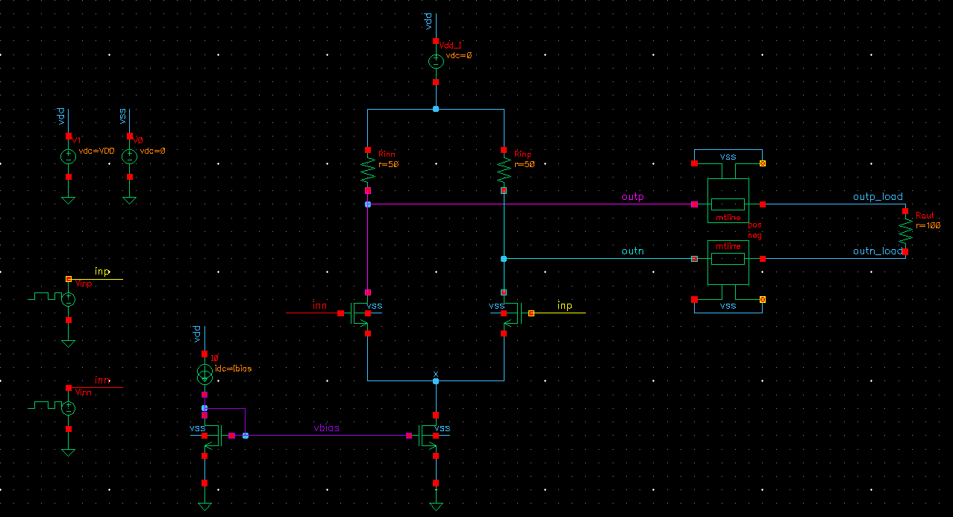
Testbench A) Without Replica
VDD=1V
LIB: analogLib
CELL: vprbs
Zero value: 0 V / 1 V
One value: 1 V / 0 V
Bit period: 1 ns
Rise/Fall times: 20 ps
Edge type: linear
Trigger: Internal
LFSR Mode: PN32

Slide 7
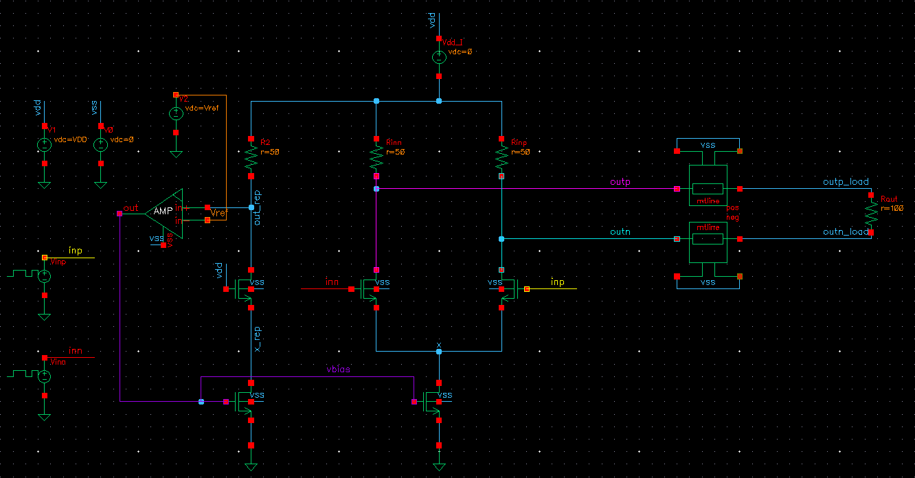
Testbench B) With Replica
VDD=1V

Slide 8

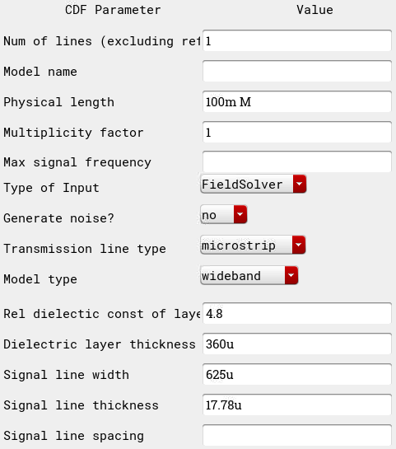
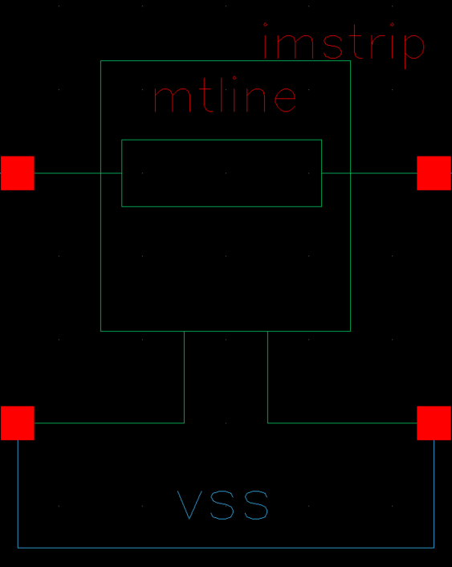
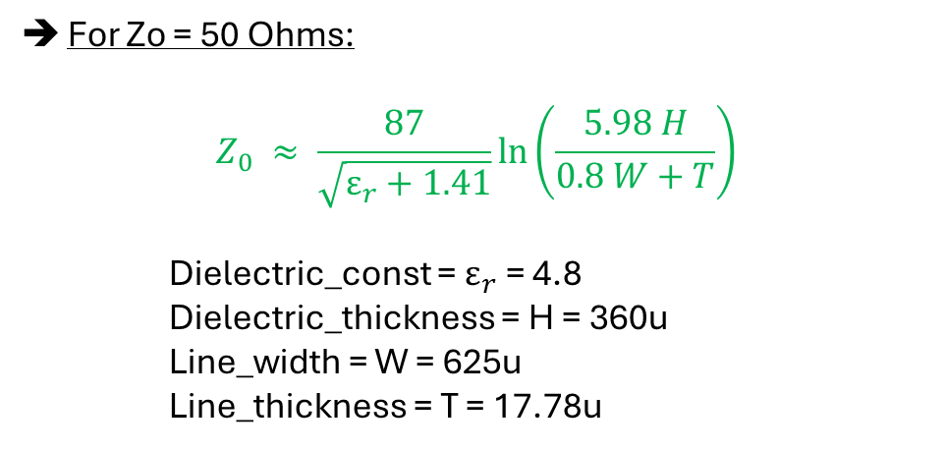
Channel Settings (mtline)
For Zo = 50 Ohms:
$$Z_{0} ≈ \frac{87}{\sqrt{ε_{r}+1.41}}\ln\left(\frac{5.98 H}{0.8 W+T}\right)$$
Dielectric_const = $ε_{r}$= 4.8
Dielectric_thickness = H = 360u
Line_width = W = 625u
Line_thickness = T = 17.78u

Slide 9
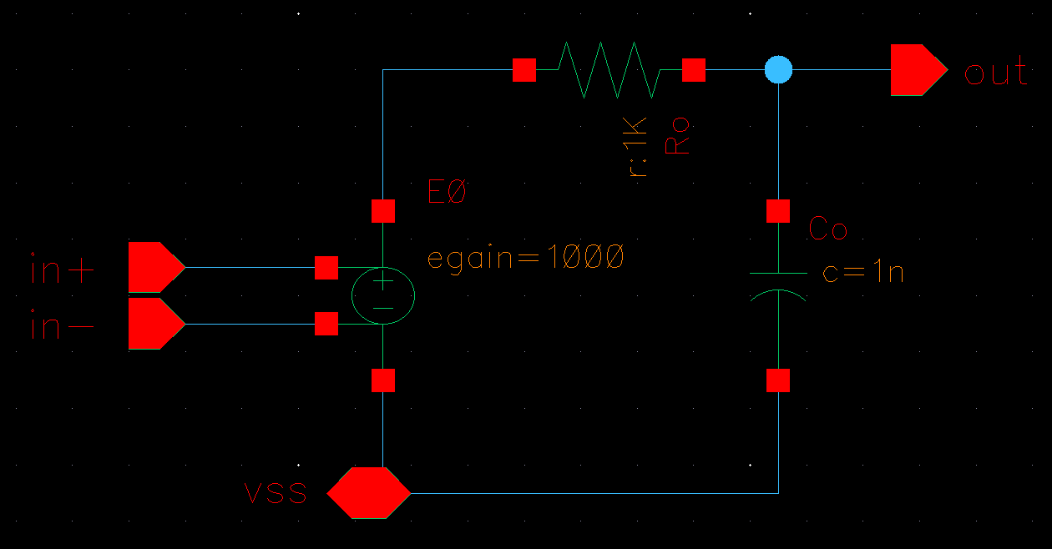
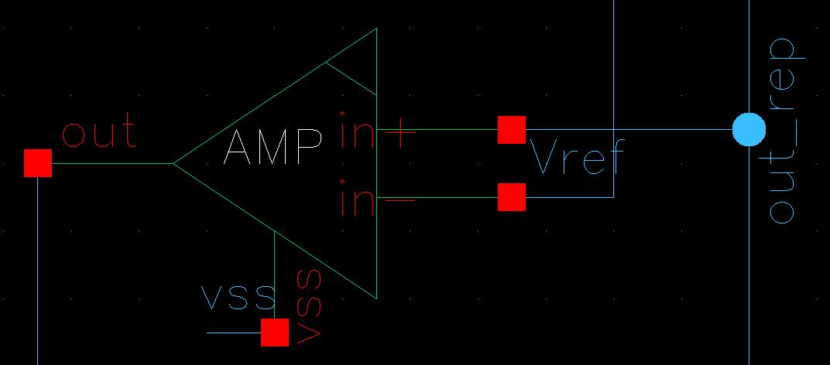

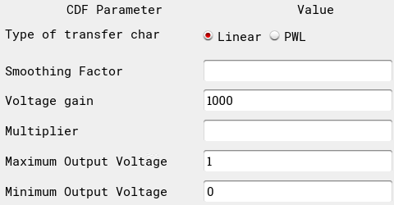
Ideal OpAmp
vcvs
(analoglib)

Slide 10
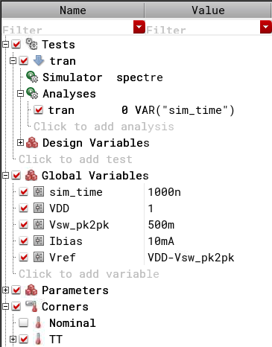
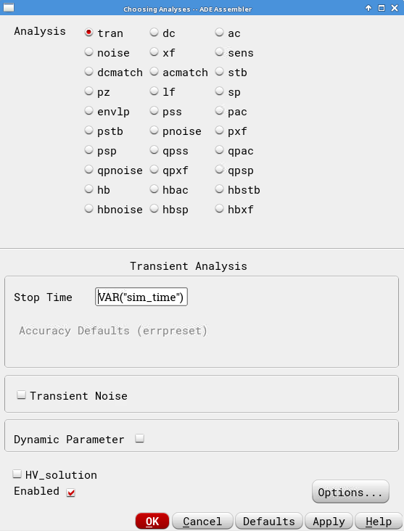
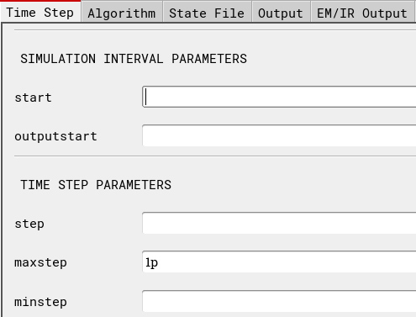
Simulation Setup

Slide 11
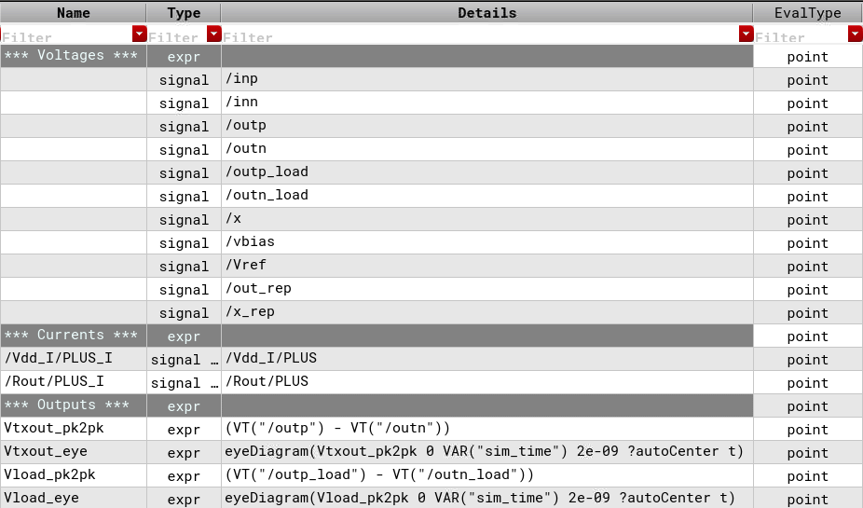
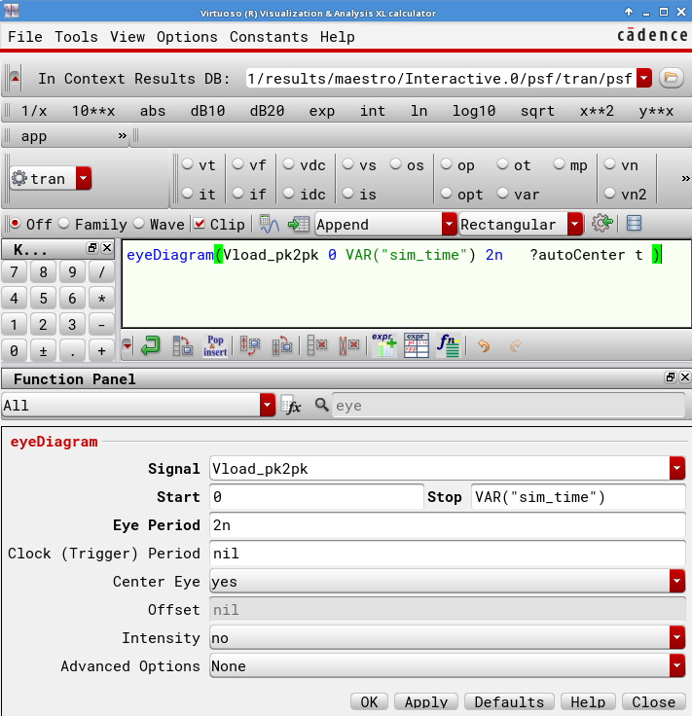
Measurements
2*UI
eyeDiagram(VT("/outp_load")-VT("/outn_load") 0 VAR(“sim_time") 2n ?autoCenter t )

Slide 12
Simulations & Results

Slide 13
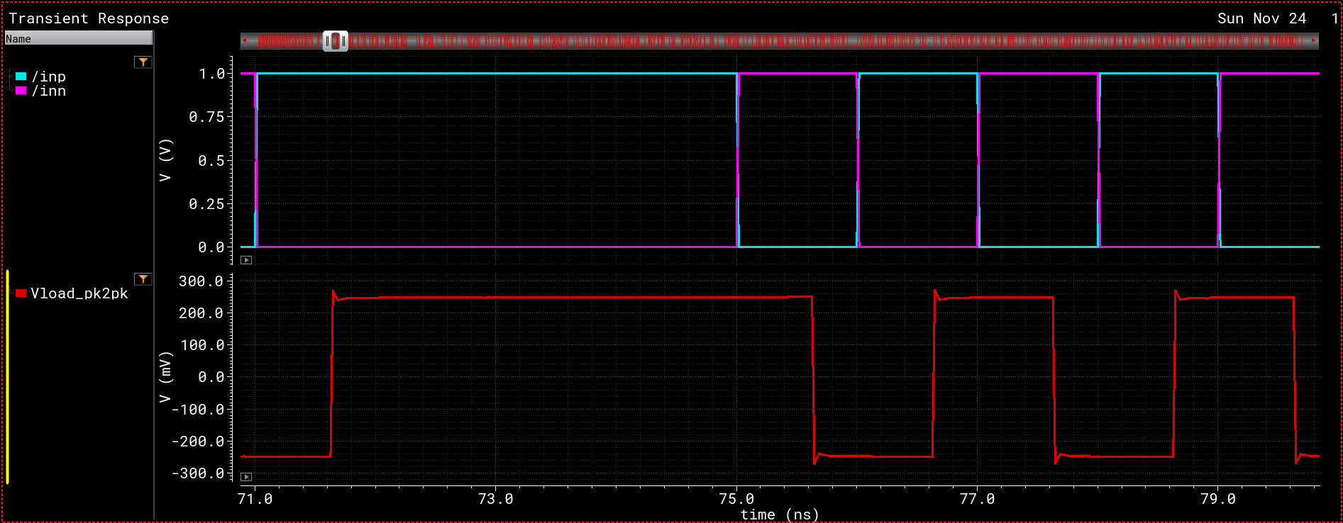
Waveforms
+250 mV
VSWING(PK2PK) = 500 mV
–250 mV

Slide 14
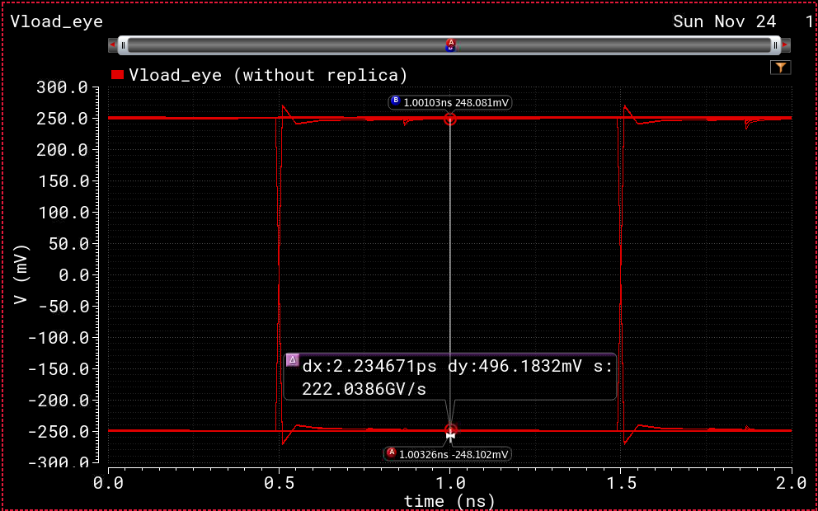
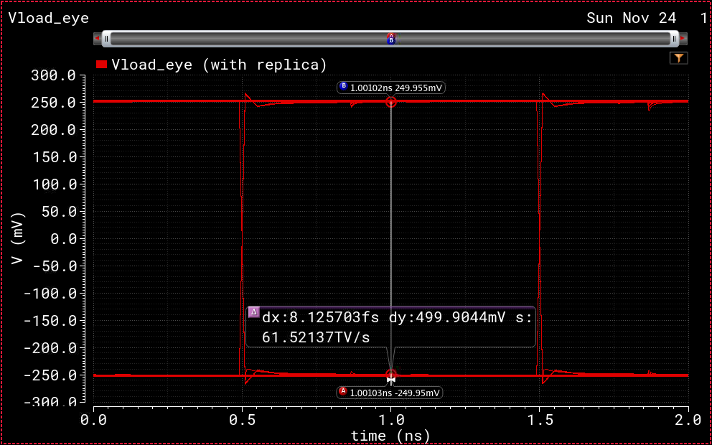
Waveforms (Eye-Diagrams)
No Replica:
VSW(pk2pk) = 496.18 mV
With Replica:
VSW(pk2pk) = 499.9 mV
➔ More Accurate Swing, at the expense of an extra branch + additional power drawn by the OpAmp
(For more info on how to measure Eye Diagrams)

Slide 15
Current Consumption
Total current drawn = 20 mA
(10 mA from main driver + 10 mA from current branch/Replica)

